Slide 1
Terminal Velocity Mission 1
Stage 1
Communicating with Measurement
Stage 2
Derived Units

Slide 2
Objectives
Evaluate systems and standards of measurement.
Use measurements to describe objects in your environment.
Discover why SI units are critical for communication among scientists, engineers, industrial partners, and societies
Explore how measurements derived from SI units can be used to further describe your physical environment

Slide 3
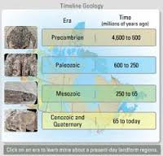
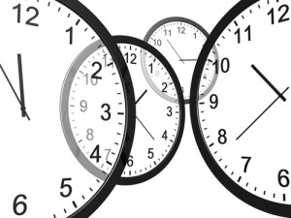
Why We Measure
Measurement uses numbers to describe processes or events.
Learning to make and communication measurements allows us to better interact with our environment.
Example: Time

Slide 4
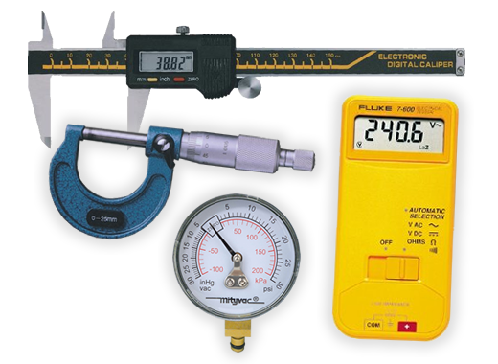
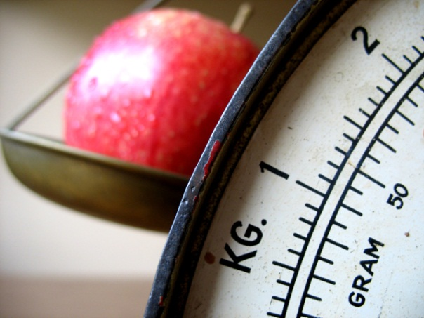
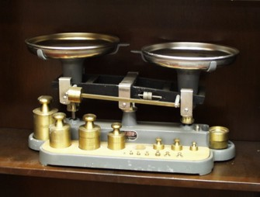
Metrology
Metrology is the study of measurement. This term comes from the Greek words metron which means “measure” and logos which means “study of”

Slide 5
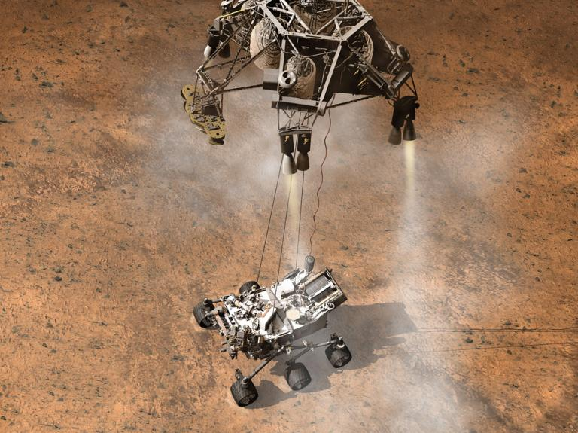
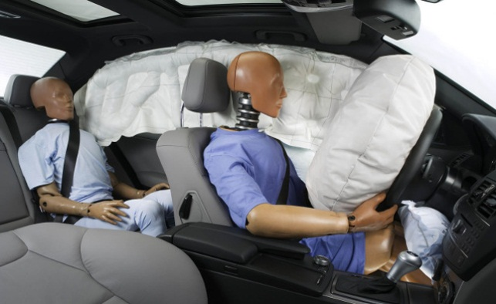
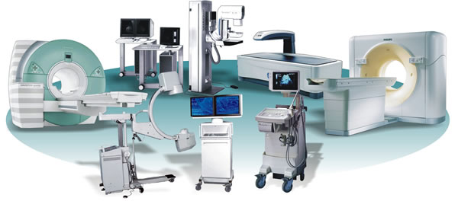
Why Accurate Measurement is Important
Development of safety equipment
Deployment of NASA missions
Diagnosis of medical conditions

Slide 6
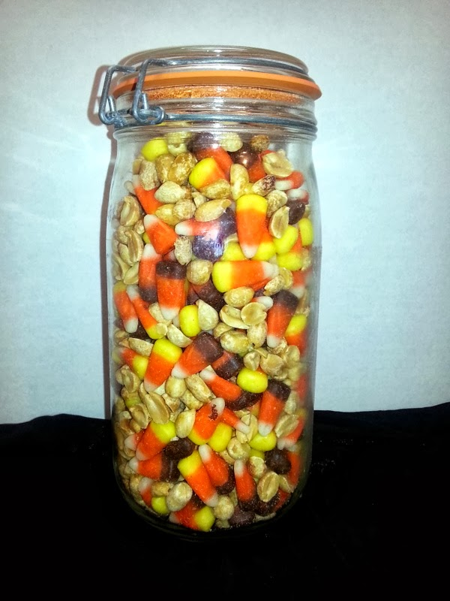
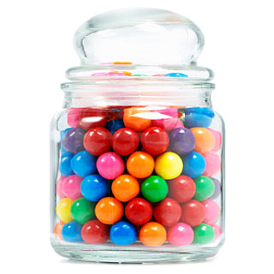
Estimates of Measurement
An estimate is an approximate measurement of an object or event.
Estimates are useful to predict the likelihood of a measurement
Notes:
Comment on the difference between estimating the number of objects of the same size in a container versus mixed objects.

Slide 7
World-Wide System of Measurements
A common system of measurement among scientist was developed to communicate information that was commonly understandable.
The metric system of measurement was adopted as the common language by most countries of the world.
The metric system is based on numbers multiplied or divided by a factor of ten

Slide 8
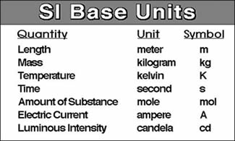
International System of Units
SI units come from its French name Systeme International d’Unites
SI units are the current world standard for measurement.

Slide 9
SI Prefixes in the Metric System
We use scientific prefixes to reduce the number of zeroes and make the figures more manageable.
For example, 54,500,000,000 meters = 54.5 giga-meters, and 400,000,000,000 meters = 400 gigameters

Slide 10
SI Prefixes

Slide 11
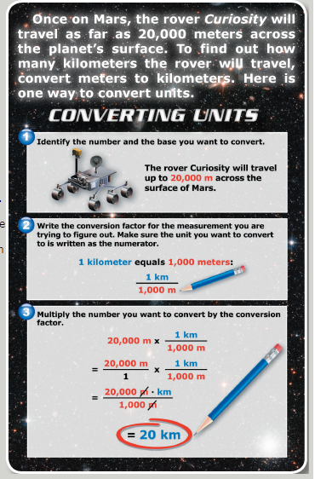
Using Prefixes for Common Conversions
Common Conversions
100 cm = 1 m
1000 m = 1 km
1000 mm = 1 m
1 km = 0.62 mi
1 kg = 2.2 lbs
1 hr = 60 min
1 min = 60 s
3600 s = 1 hr

Slide 12
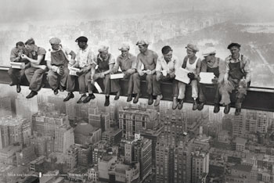
Conversions
Convert your mass in lbs to kg.

Slide 13
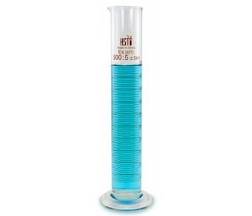
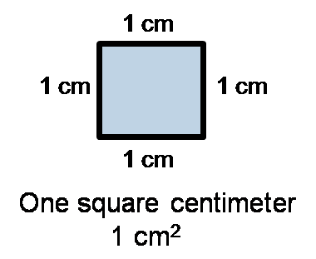
SI Derived Units
Derived units combine SI units to allow people to better describe the world.
These derived units use more than one measurement at a time. Examples of these are:
Area
Volume
cm³ or ml

Slide 14
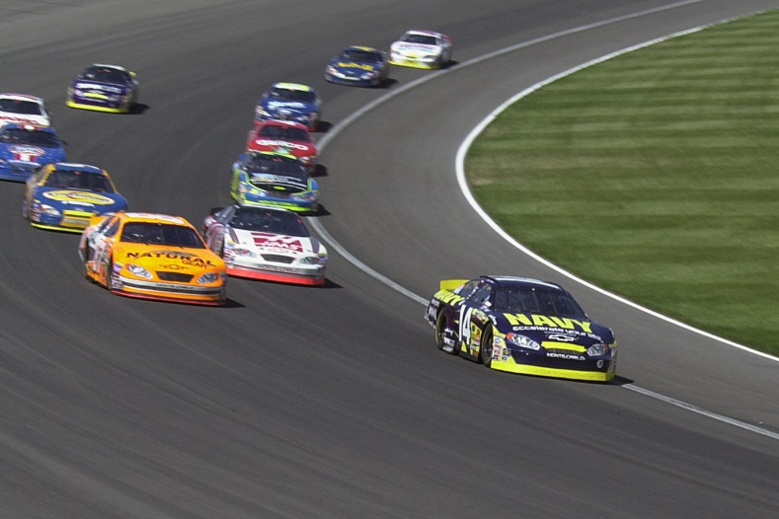
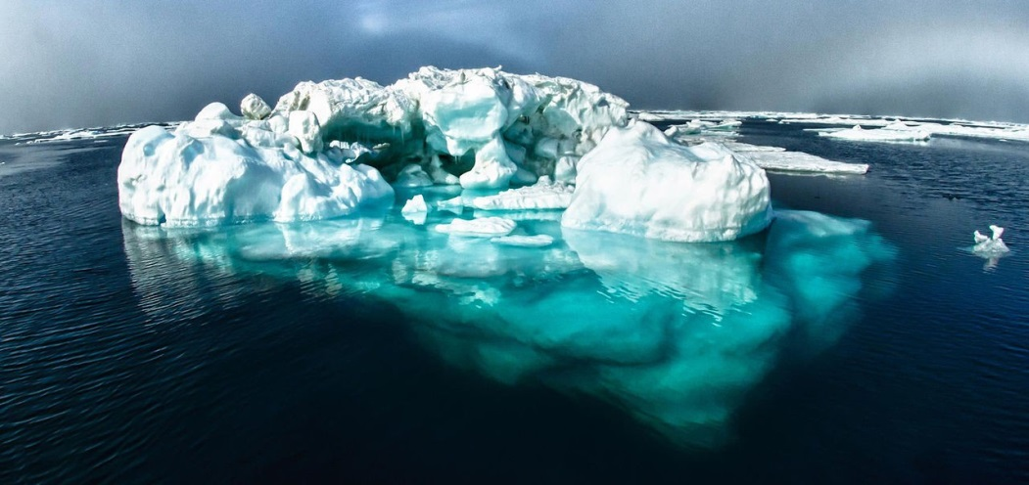
More Derived SI Units
Velocity
m/s
Density
g/cm³

Slide 15
Conversions
Once you have your base SI units down and your prefixes on hand, you can begin to do conversions!

